Slide 1
Introduce the web site “BIG MOTORS”
Group 5 Web Wizardry Warriors
M23W7440 Prabhath Dilshan Landekumbura(Team Leader)
M23W7281 Walakumburage Janaka Nalaka Priyantha
M24W0633 Kanakarathne Kasun Madhawa
M23W7397 Malavi Arachchi Gamage Chamara

Slide 2
Introduction
This is the website for BIG MOTORS, a company providing automobile services.
The website aims to inform customers about our services.
Our target audience includes car owners in Japan who need reliable repair and maintenance services.

Slide 3
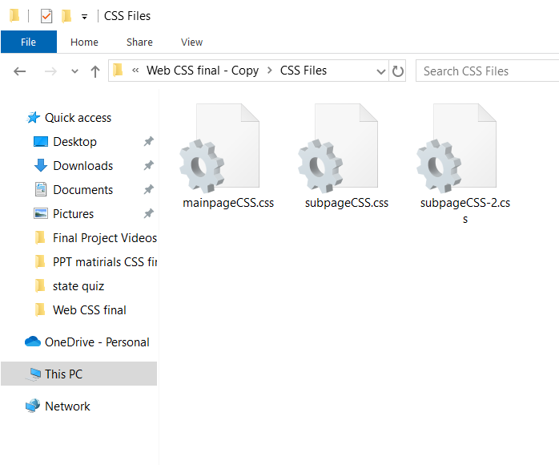
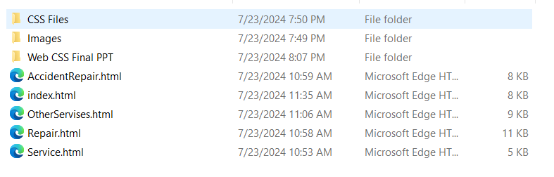
Website Features
Contains
5 .HTML files & 3 .CSS files
Home: "Introduction to BIG MOTORS, key highlights, booking form, Google Maps integration."
Services: "Detailed overview of services offered."
Repair: "Information on repair services."
Accident Repair: "Details on accident repair services."
Other Services: "Additional services like roadside assistance."

Slide 4
Features
Navigation bar - easy access to all pages
Carousel section - allowing users to photos of services provided by company
Booking form - booking form to schedule services
Google map iframe - Maps to show our location
Social media hyperlinks - Links to social media pages
Back to top floating button - Scroll to top button for user convenience
Responsive to screen sizes - Allows better users expiriance

Slide 5
Website Improvements
want to improve the process of saving form data to the database.
Include customer testimonials and reviews to build trust.
include media gallery
Enhance the design to make it more attractive and user-friendly
use more animation.
use attractive background colors and images.

Slide 6
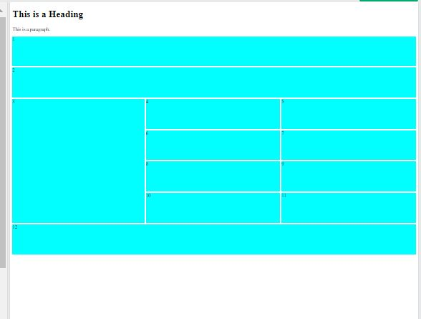
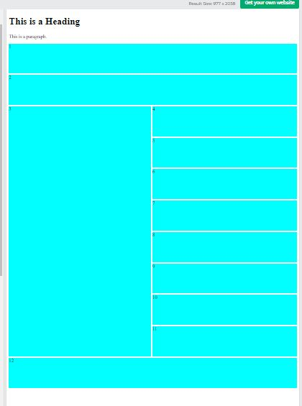
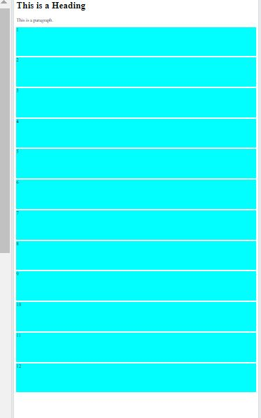
Code Review
For the Index.html
Used display : grid;
@media (min-width: xxx px)
Larg Screens
Tablets and small screens
Mobile screens

Slide 7
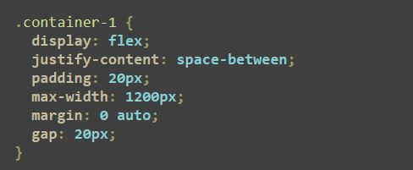
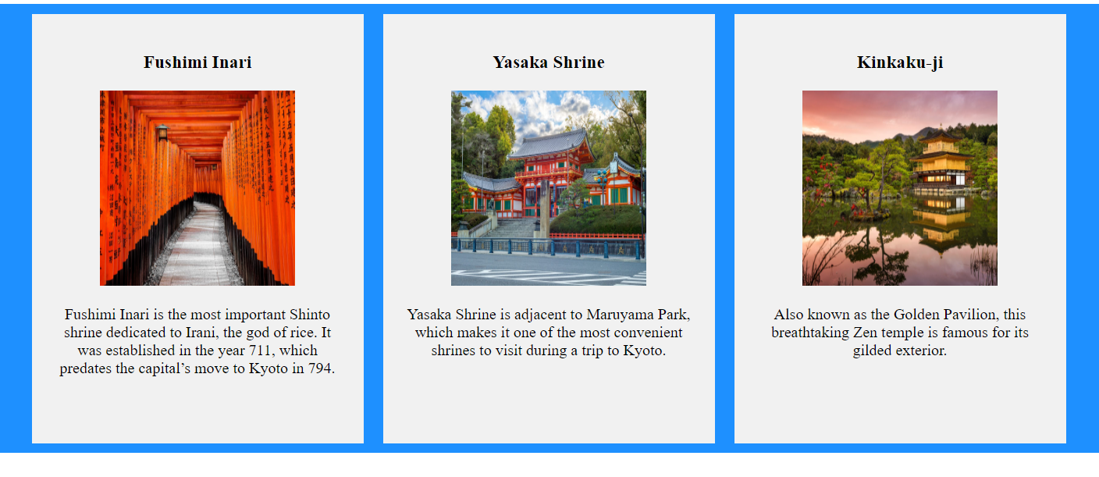
Code Review
For the sub pages
Used display : flex ;
Code is influenced by
Class lecture

Slide 8
Thank you!!

